Slide 1
Stacks
Materials are adapted from “Data Structures: A Pseudocode Approach with C,” 2nd ed., by Richard F. Gilberg & Behrouz A. Forouzan

Slide 2
Stack
A stack is a linear list in which additions and deletions of data are restricted to one end, called the top.
If we insert a data series into a stack and then remove it, the order of data is reversed.
Stacks are known as the last in–first out (LIFO).

Slide 3
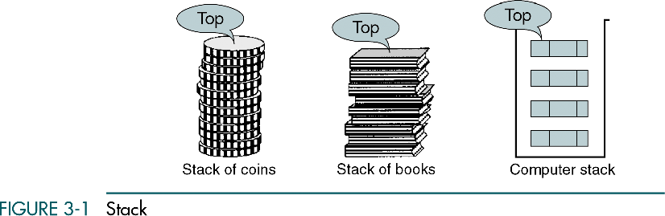

Slide 4
Stack Operations
Three basic operations
Push : inserts data into the stack
Pop : removes data from a stack and returns the data to the calling module
Stack top : returns the data at the top of the stack without deleting the data from the stack

Slide 5
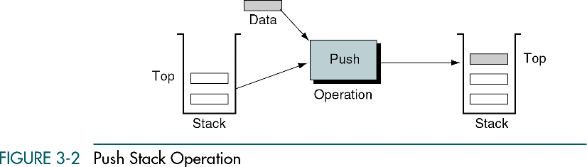
Push
Push adds an item at the top of the stack
After the push, the new item becomes the top
The only potential problem
We must ensure that there is room for the new item
If there is not enough room, overflow state

Slide 6
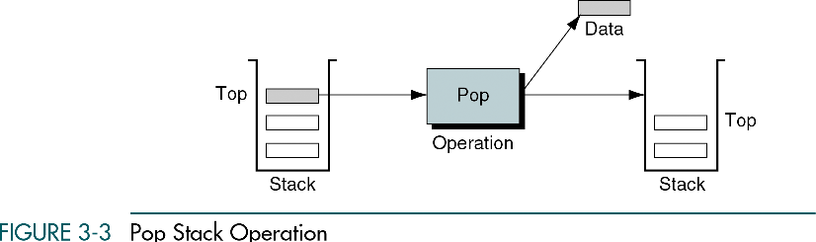
Pop
Pop removes the item at the top of the stack and return it to the user
The next older item becomes the top
If pop is called when the stack is empty, underflow state

Slide 7
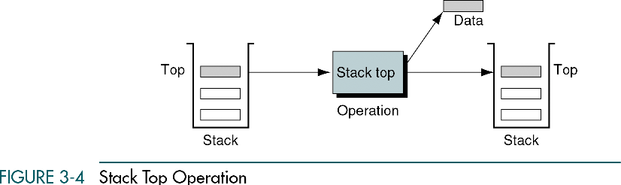
Stack top
Stack top copies the item at the top of the stack
Returns the data in the top element but does not delete it
Reading the stack top

Slide 8
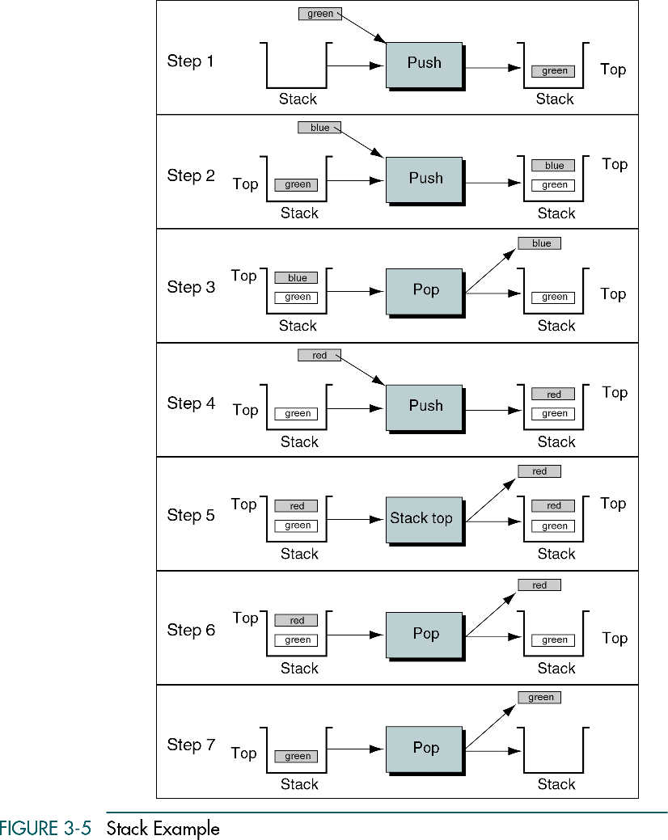

Slide 9
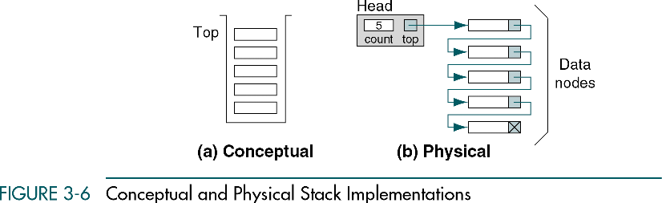
Stack Linked List Implementation
Data structure
Head
Metadata
A pointer to the top of the stack
Data node
Data
A link pointer to the next node in the stack

Slide 10
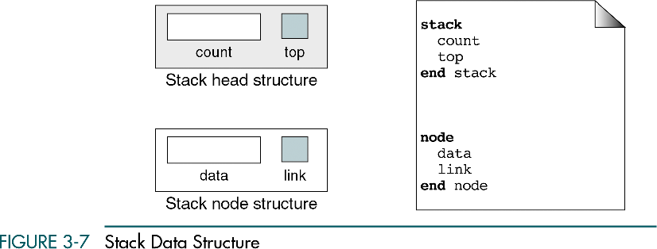
Stack data structure

Slide 11
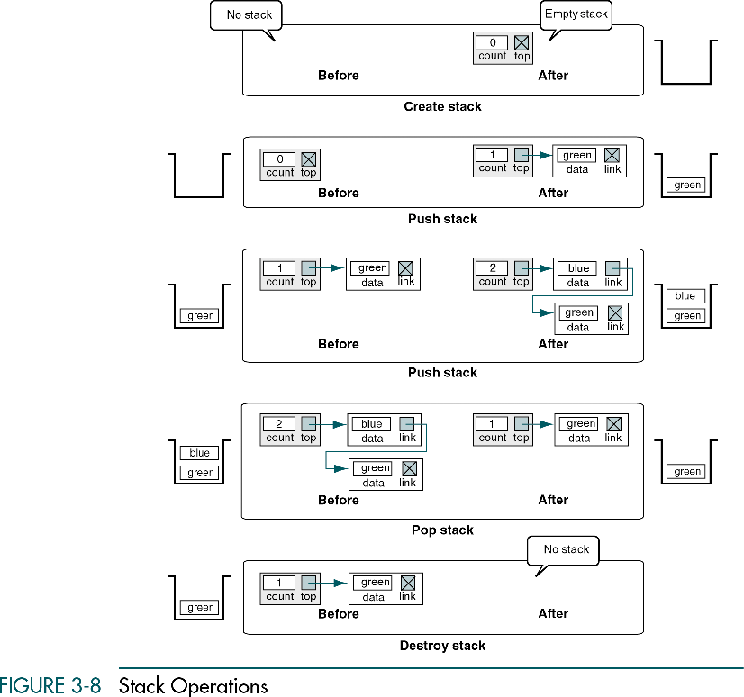

Slide 12
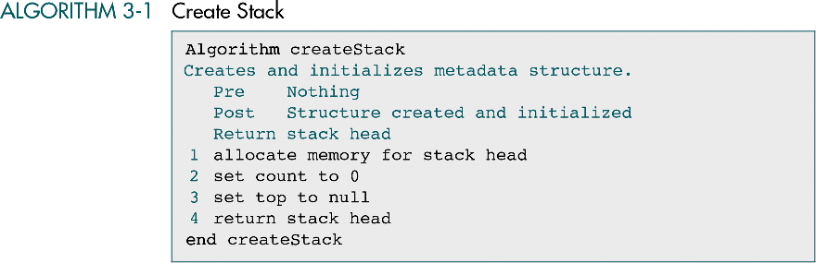
Create stack
Create stack
Allocates memory for the stack structure and initializes its metadata

Slide 13
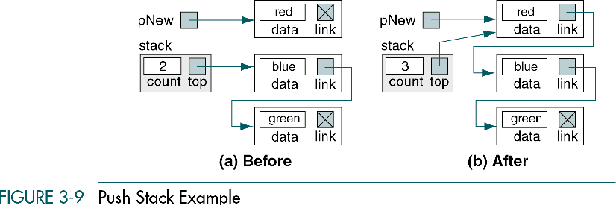
Push stack
Push stack
Inserts an element into the stack

Slide 14
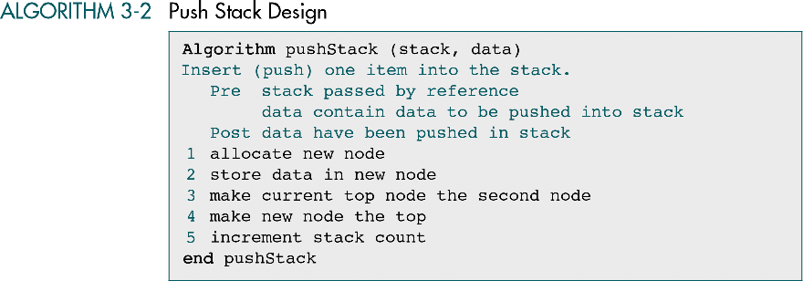
Push stack
The logic for inserting into a stack with data and into an empty stack are identical

Slide 15
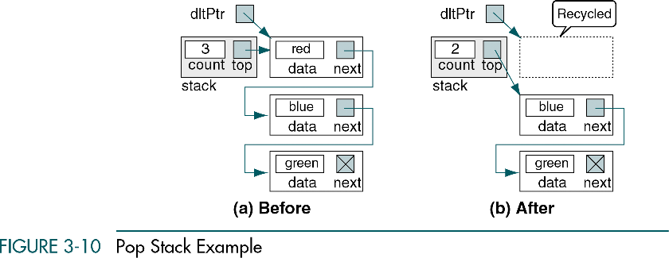
Pop stack
Pop stack
Sends the data in the node at the top of the stack back to the calling module
Then adjusts the pointers to logically delete the node
Physically deletes the memory
“next” means ”link”

Slide 16
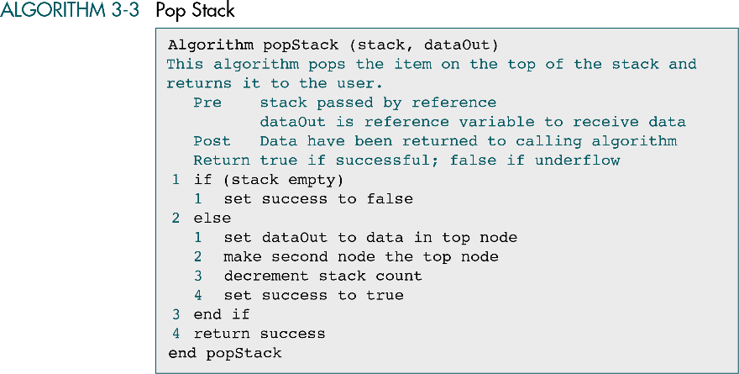
Pop stack

Slide 17
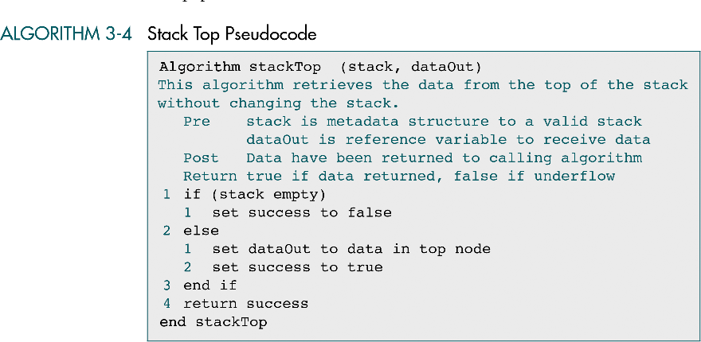
Stack top
Stack top
Without deleting the top node, sends the data at the top of the stack back to the calling module

Slide 18
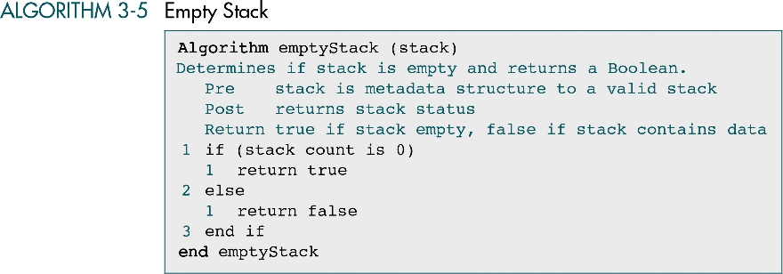
Empty stack
Empty stack
Provides a way to determine whether the stack is empty
If the entire program cannot access to the stack head structure, it is needed

Slide 19
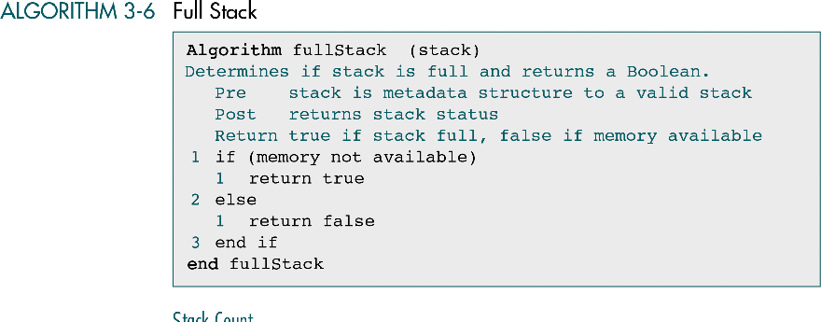
Full stack

Slide 20
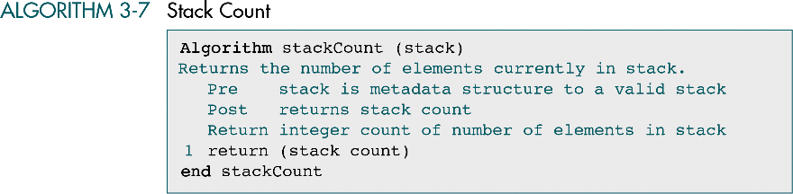
Stack count
Stack count
Returns the number of elements currently in the stack

Slide 21
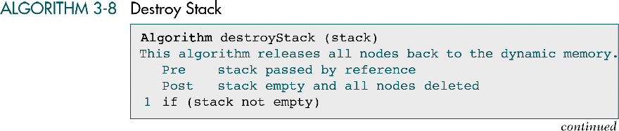
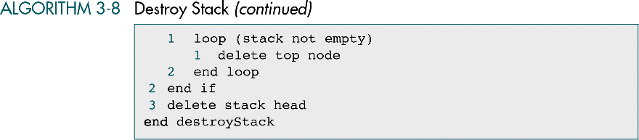
Destroy stack
Destroy stack
Deletes all data in a stack

Slide 22
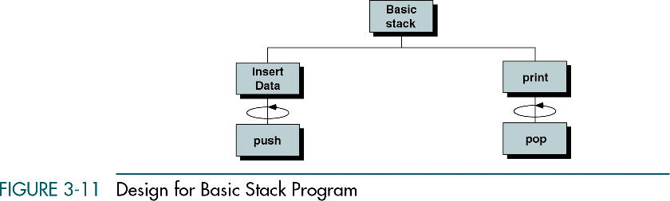
C Language Implementations
a simple non-ADT implementation of a stack
Easy to write but not reusable
a simple program that inserts random characters into the stack and then prints them

Slide 23
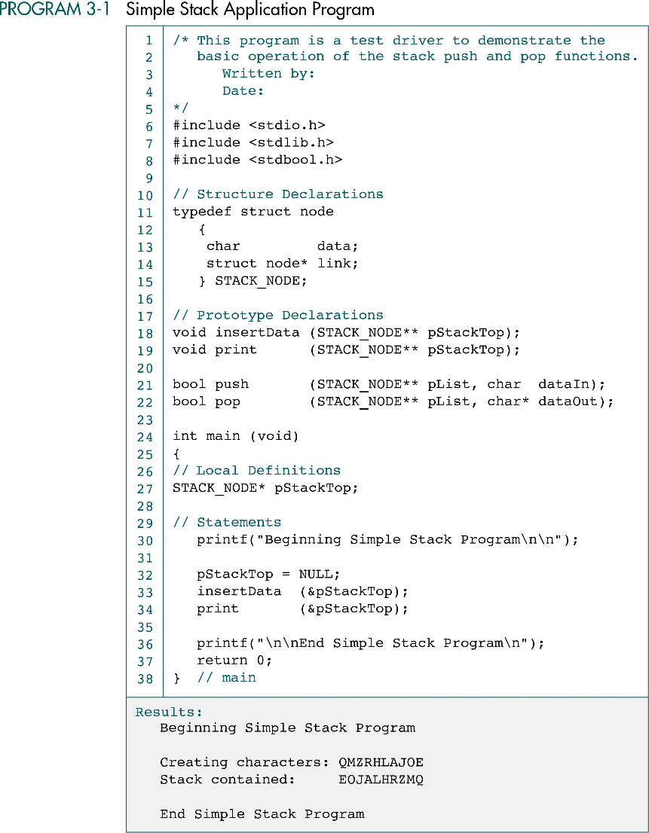

Slide 24
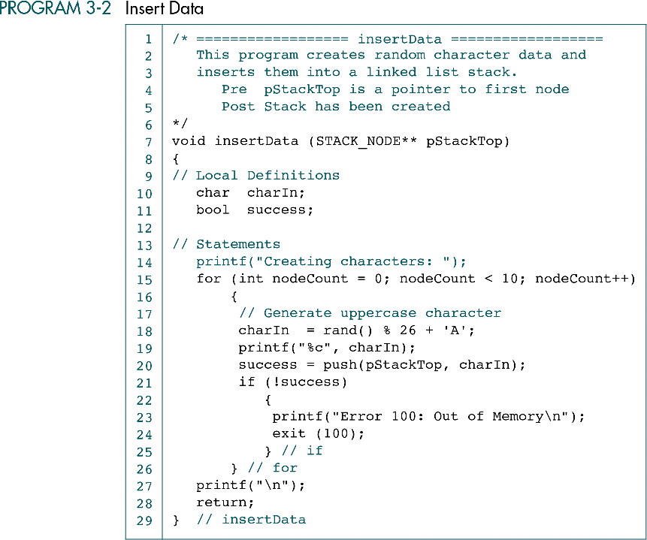

Slide 25
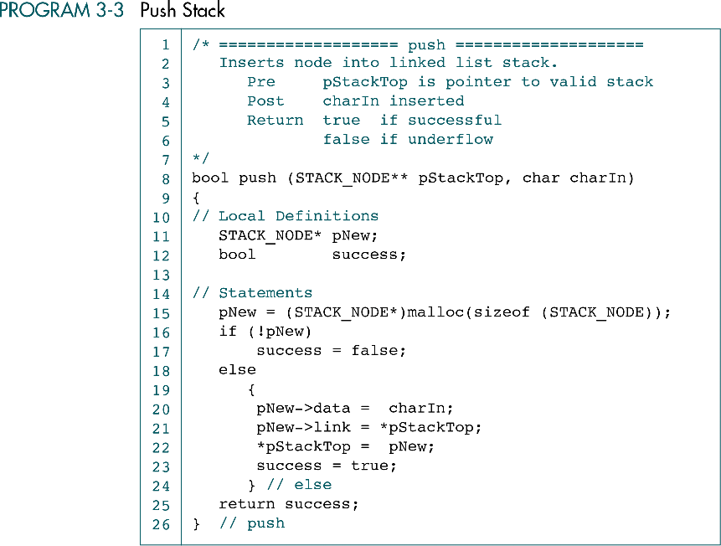

Slide 26
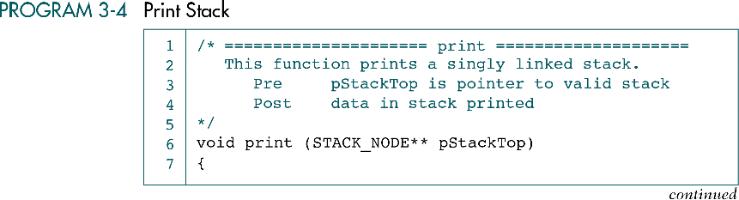
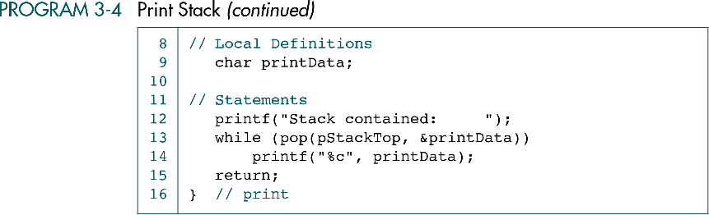

Slide 27
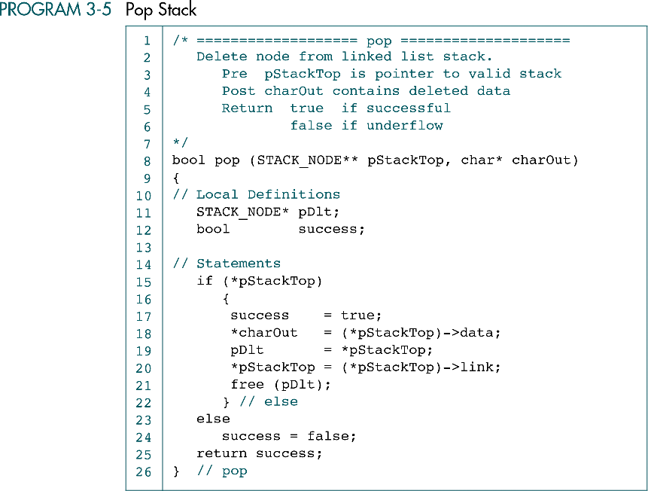

Slide 28
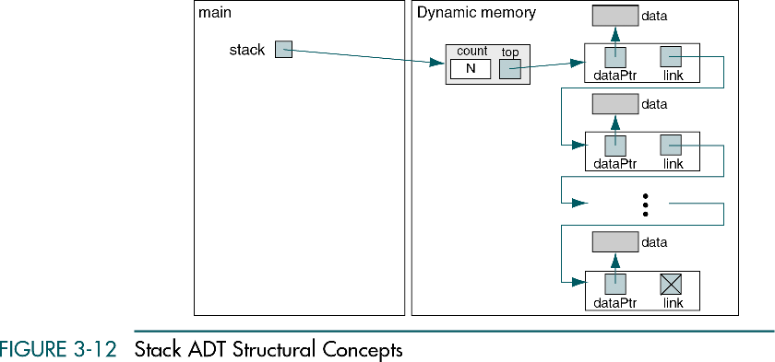
Stack ADT
Data Structure

Slide 29
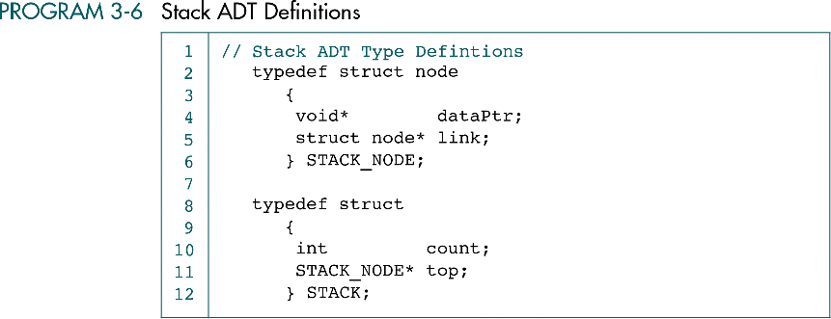

Slide 30
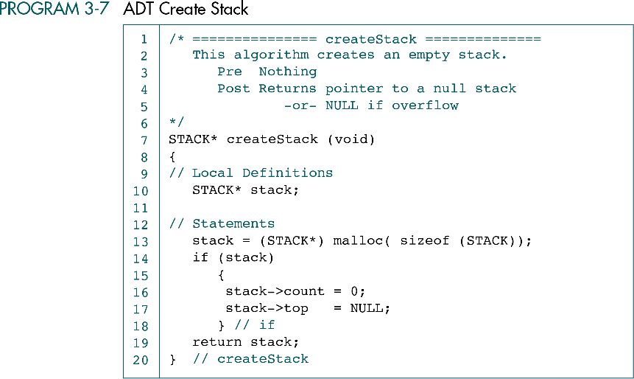

Slide 31
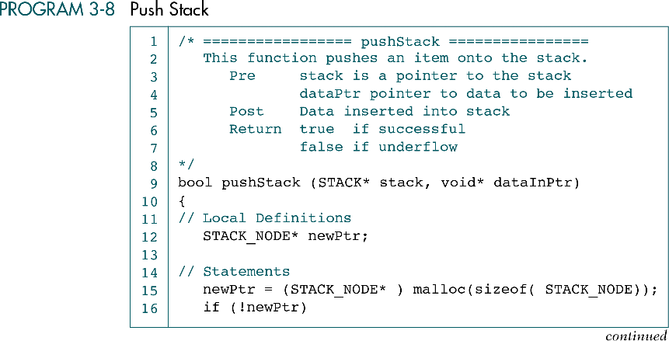
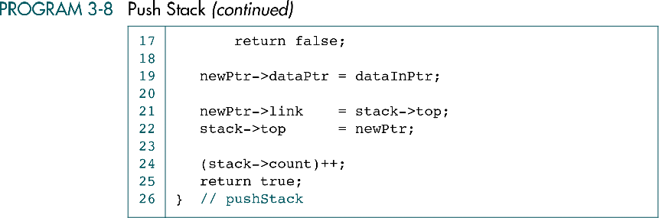

Slide 32
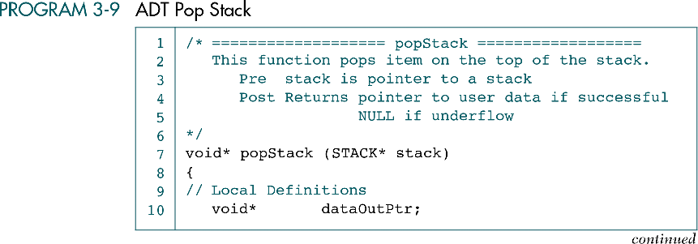
11 12 13 14 15 16 17 18 19 20 21 22 23 24 25 | STACK_NODE* temp; // Statements if (stack->count == 0) dataOutPtr = NULL; else { temp = stack->top; dataOutPtr = stack->top->dataPtr; stack->top = stack->top->link; free(temp); (stack->count)--; } // else return dataOutPtr; } // popStack

Slide 33
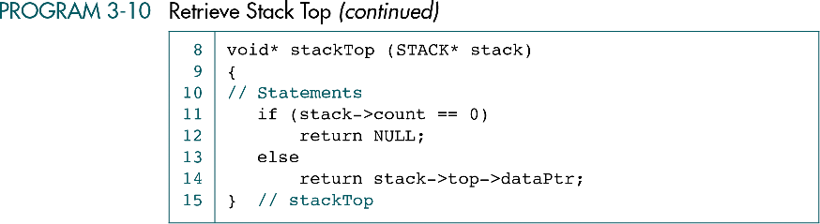

Slide 34
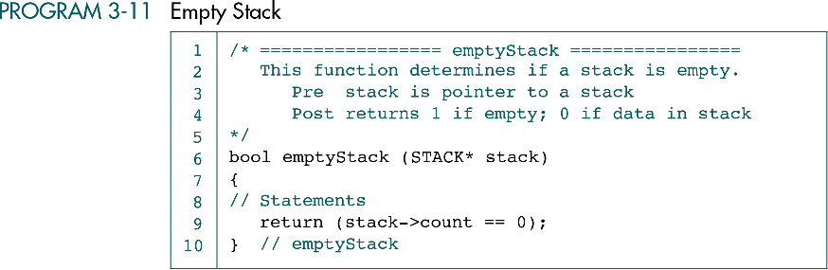

Slide 35
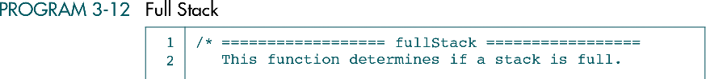
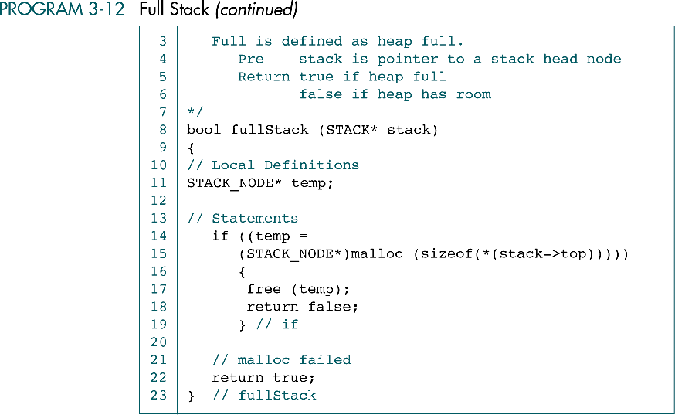

Slide 36
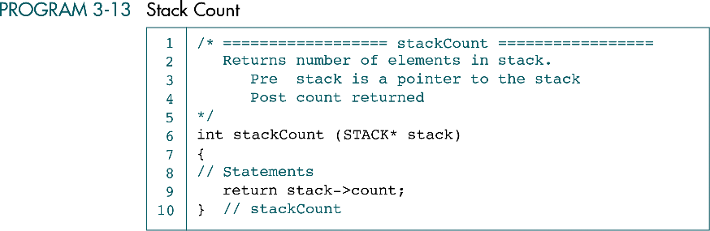

Slide 37
